Slide 1

IoT Low level BLE Project

Slide 2
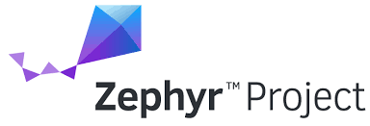
What is zephyr ?
Zephyr is an open-source platform.
Intended for use in real-time operating system (RTOS).
for connected devices with constrained resource.
Zephyr is modular and supports multiple architectures.

Slide 3
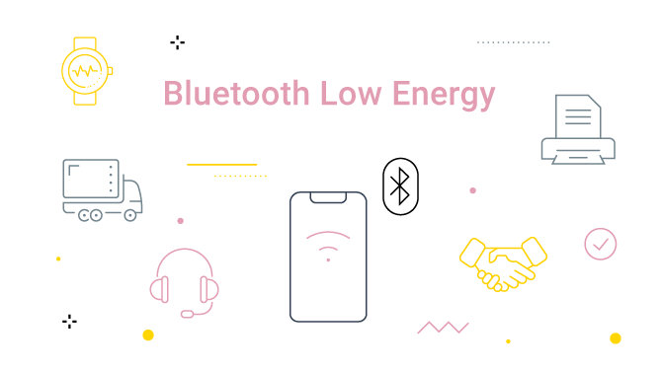
Bluetooth Low Energy (BLE)
Low power
Easy Connection
Small amount of data

Slide 4
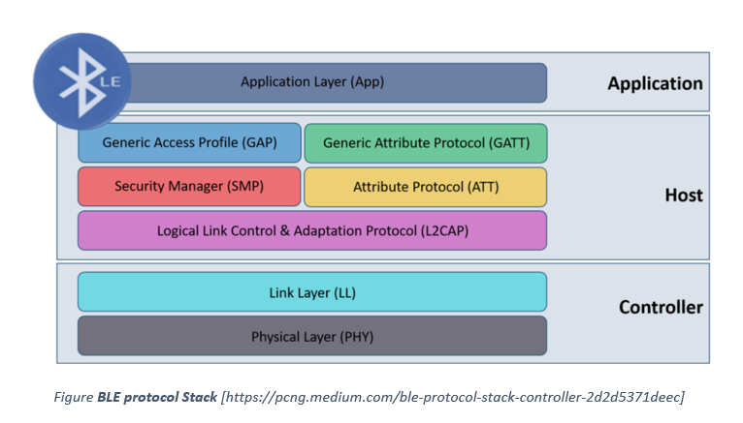
What is GAP and GATT?
GAP defines the general topology of the Bluetooth Low Energy (BLE) network stack.
GATT describes in detail how attributes (data) are transferred once devices have a dedicated connection.

Slide 5

GATT Read, Write
Each attribute can have one of four access permissions:
None: The attribute can neither be read nor written by a client.
Readable: The attribute can be read by a client.
Writable: The attribute can be written by a client.
Readable and writable: The attribute can be both read and written by the client.

Slide 6
notifications
A Notification is an unacknowledged message
Client preforms discovery to find out which services, characteristics, and descriptors are present on the server.
Sent any time the relevant data in the GATT table on the GATT Server is updated.

Slide 7
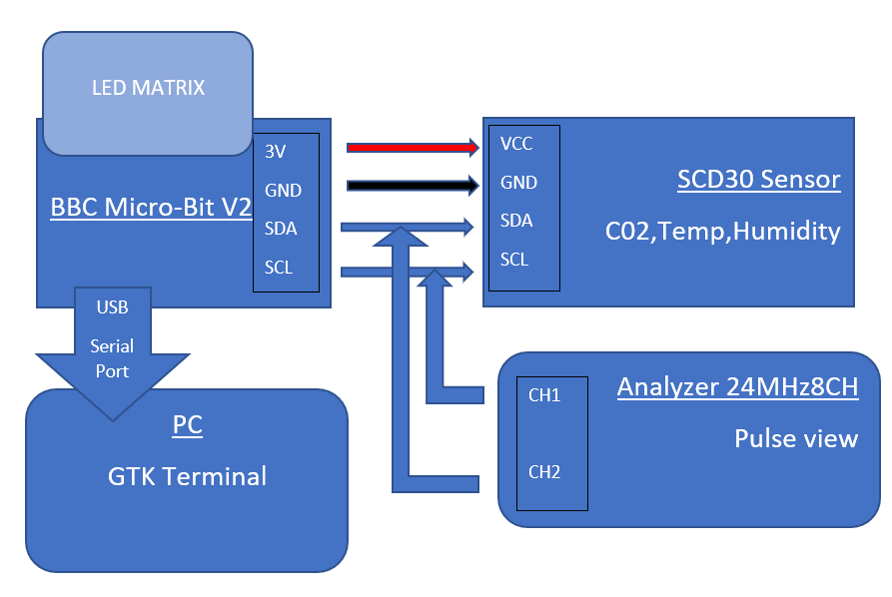
Circuit Diagram of the set up

Slide 8
Sources
https://www.zephyrproject.org/learn-about/
https://punchthrough.com/how-gap-and-gatt-work/
https://www.oreilly.com/library/view/getting-started-with/9781491900550/ch04.html
https://www.lairdconnect.com/support/faqs/what-difference-between-indication-and-notification

Slide 9

Thank You

